Slide 1
Response to Radiation Events
Romeo Fairley, MD, MPH, FACEP
UT Health – San Antonio

Slide 2

Disclosures
Notes:
No financial disclosures.

Slide 3
Objectives
Radiation Basics
Radiation Sources
Threat Level
Initial Response
Dose Estimation
Acute Radiation Syndrome
Real Life Situations

Slide 4
Radiation Basics

Slide 5
Radioactivity
Units of activity, quantity of radioactive material in which one nucleus decays per second
Conventional unit: Curie
International system unit: Becquerel
Absorbed Dose
Units of exposure, describes amount of radiation produced given a number of ionizations in air
Conventional unit: rad
International system unit: Gray (Gy)
1 Gy = 100 rad
Dose equivalent
Units of absorbed dose, describes radiation energy imparted to matter (body)
Conventional unit: Roentgen equivalents man (rem)
International system unit: Sievert (Sv)
1 Sv = 100 rem
Notes:
Don’t worry, more words on this slide than rest of the ppt.

Slide 6
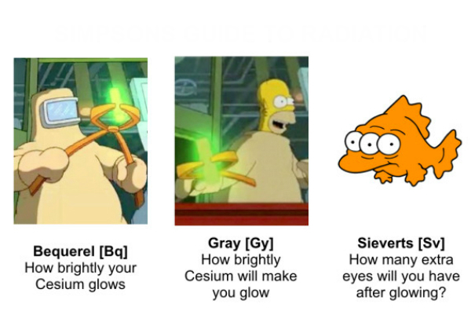
Bequerel [Bq]
How brightly your Cesium glows
Gray [Gy]
How brightly Cesium will make you glow
Sieverts [Sv]
How many extra eyes will you have after glowing
Notes:
From Google search.

Slide 7
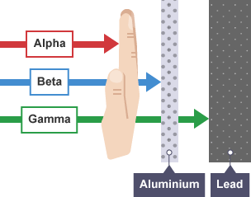
Notes:
Alpha particle - two protons and two neutrons bound together into a particle identical to a helium-4 nucleus (no electrons)
Beta particle - fast-moving electron emitted by radioactive decay of substances
Gamma ray – electromagnetic wave with shortest wavelength

Slide 8
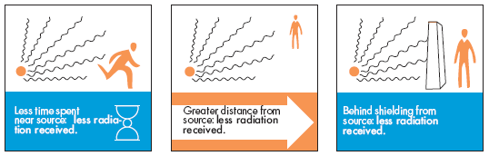
Time
Distance
Shielding
Notes:
3 important ways to protect against irradiation.
Distance is most beneficial due to inverse square law. For example, if you are 4 feet away you receive 1/16th the dose compared to 1 foot away.

Slide 9
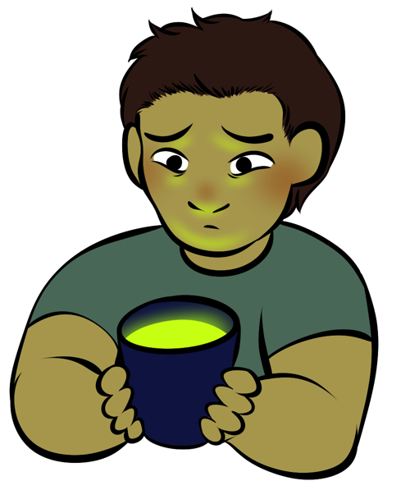
Contaminated vs. Irradiated
Notes:
If they drink the water contaminated, otherwise just irradiated.
Contaminated patients potentially dangerous to surrounding individuals.
Irradiated patients NOT dangerous to surrounding individuals.

Slide 10
Radiation Sources

Slide 11

Notes:
Cosmic radiation

Slide 12
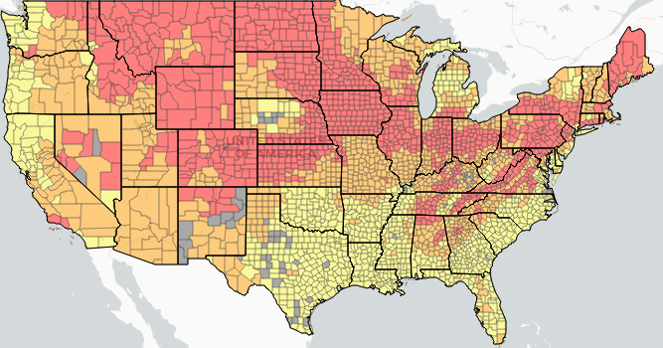
Low
Moderate
High
http://www.city-data.com/radon-zones/
Notes:
Radon is the majority of non-medical radiation exposure for humans.
2nd leading cause of lung cancer behind tobacco smoke.
colorless, odorless, radioactive gas
Different zones of Radon potential as per Environmental Protection Agency (EPA)
San Antonio is in low risk area of the county (Zone 3), most of Texas is low risk except panhandle and far west are Zone 2 (moderate risk).

Slide 13

3.5 mSv / year
Notes:
Just for living in USA, average of 3-3.5mSv per year, bulk of dose is from Radon, some from cosmic radiation depending on elevation.

Slide 14

0.035 mSv
Notes:
From cosmic radiation get a dose of 0.035 mSv while flying cross country

Slide 15
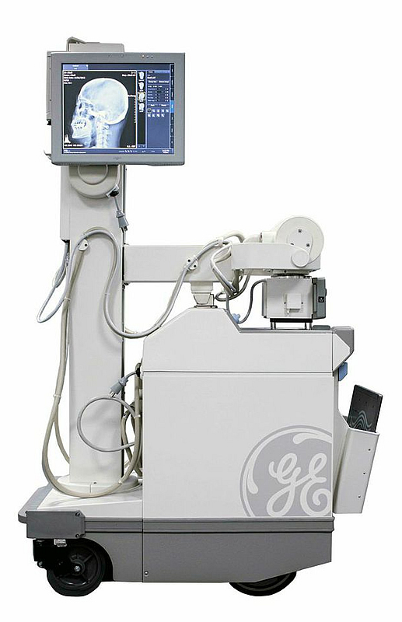
CXR = 0.1 mSv
Extremity = 0.001 mSv

Slide 16
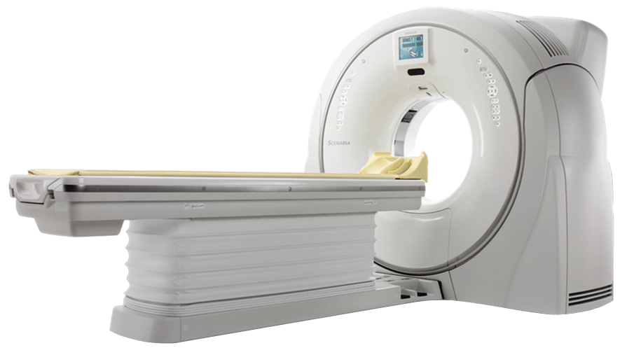
2 to 30 mSv
Notes:
Head CT = 2 mSv
Chest CT = 10 mSv
Abd/pelvis = 15 mSv
Abd/pelvis multiphase = 30 mSv
Trauma WBCT (whole body CT) = 30 mSv

Slide 17
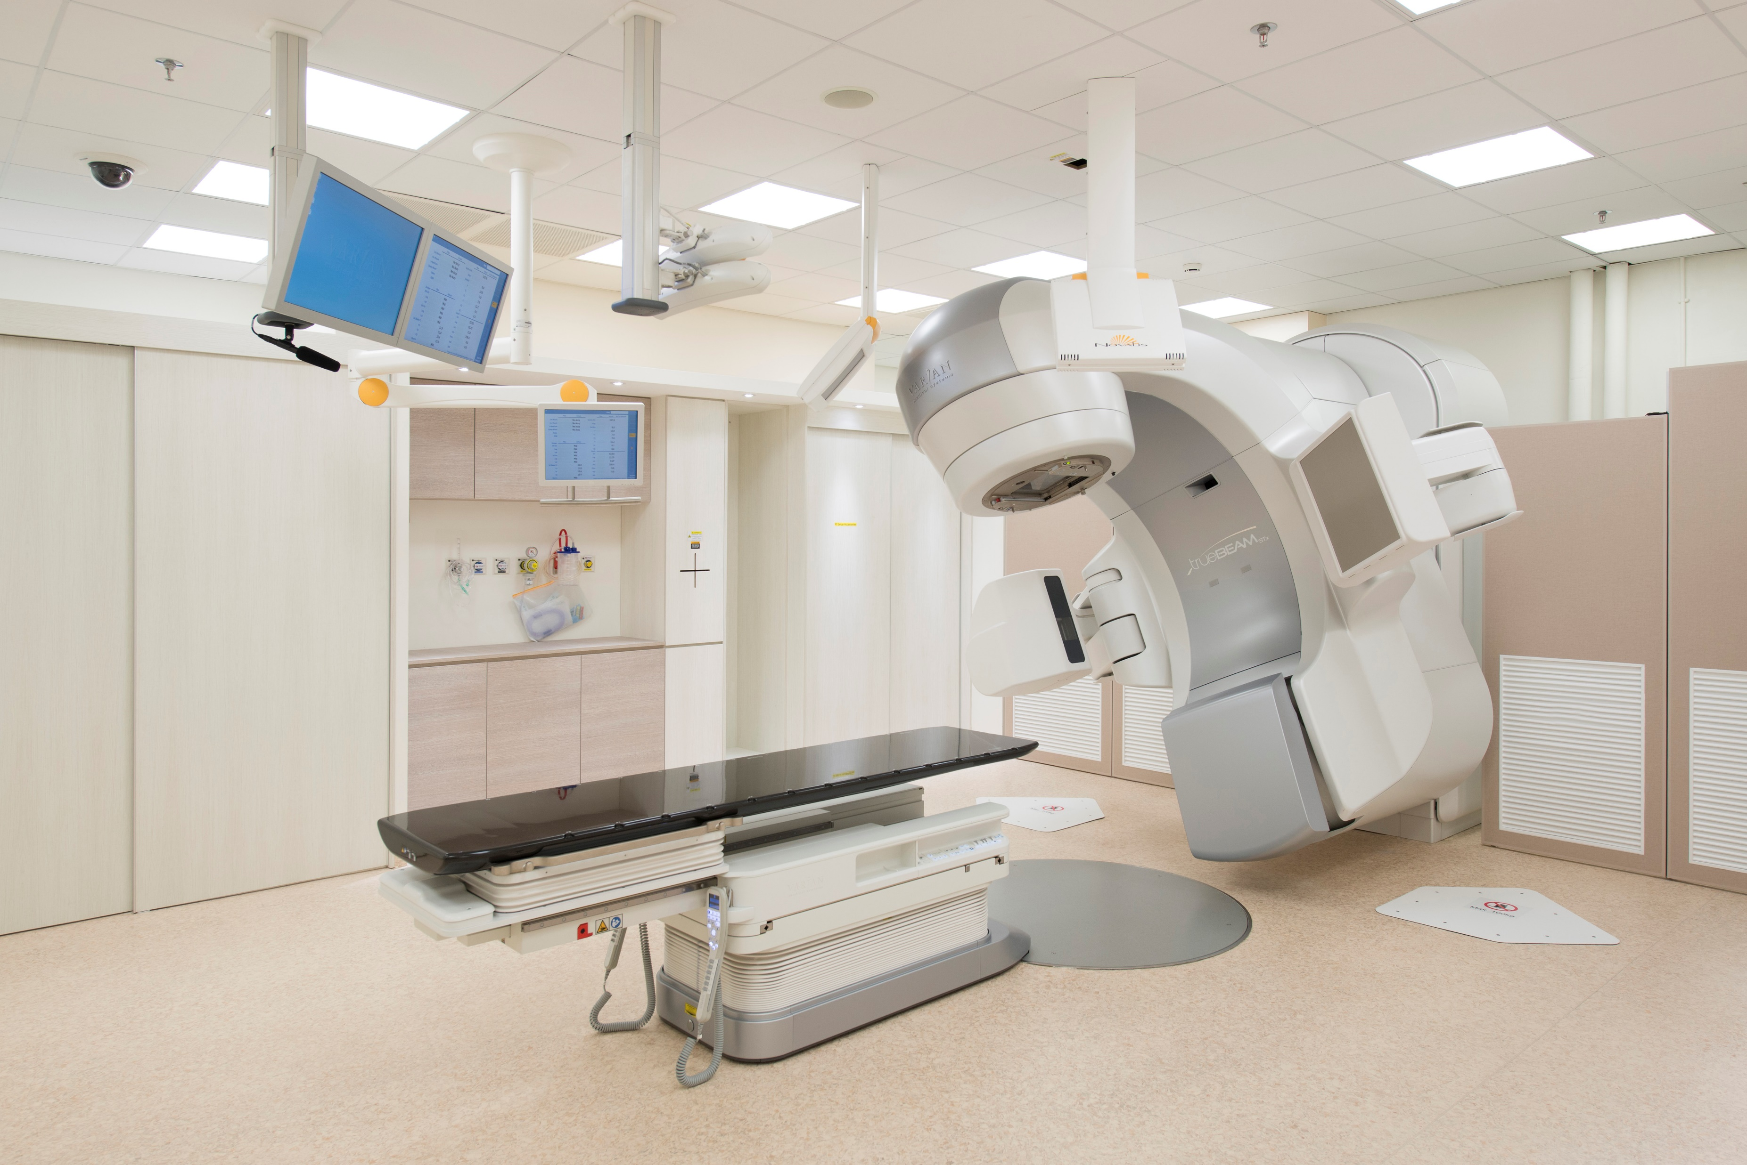
Notes:
Radiotherapy machine, use radioactive sources to deliver therapeutic radiation.

Slide 18
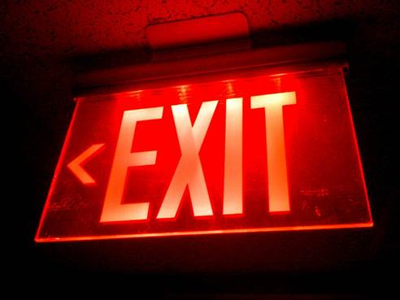
Notes:
Tritium based signs, glow without electricity.
Tritium is radioactive isotope of hydrogen.
Beta particles, harmful if swallowed or inhaled.
Not for normal trash disposal.

Slide 19
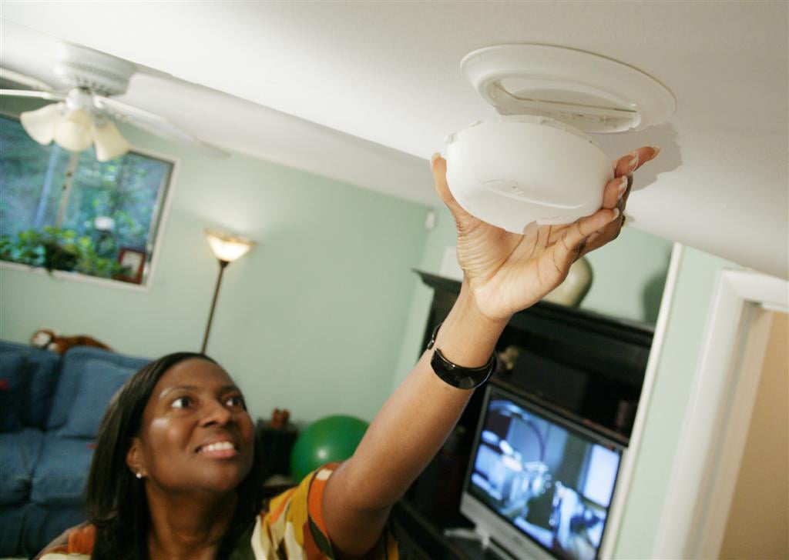
Notes:
Americium-241 in smoke detectors.
Alpha particles, minimally harmful.
Can be disposed in normal trash.

Slide 20
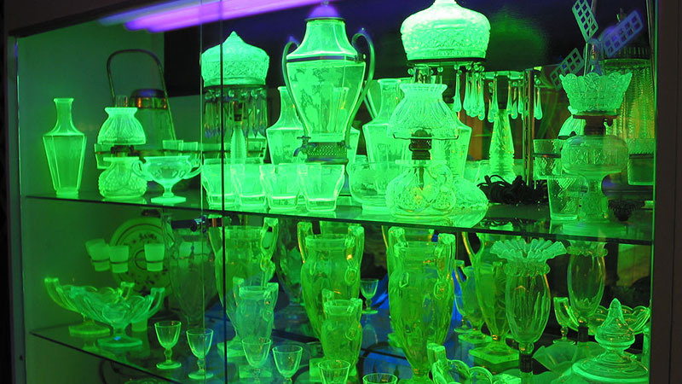
Notes:
Vaseline glass contains Uranium.
Many antiques made with radionuclides to give color/glow.
Can give off alpha, beta, gamma rays. Not for use with food products.

Slide 21
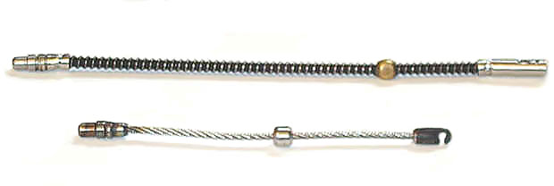
Notes:
Industrial radiography source.
iridium-192 and cobalt-60 are two most common sources
At 1.0 meter, unshielded, 160 mSv/hour (33.7 Curies of Ir-192)

Slide 22
Threat Level

Slide 23
International Incident and Trafficking Database (ITDB) of IAEA
Since 1993, over 2890 confirmed incidents
Over 15% are unauthorized possession and related criminal activities
https://www.iaea.org/publications/factsheets
Notes:
IAEA – International Atomic Energy Agency

Slide 24
Texas Department of State Health Services
2011-2014: 370 incidents (licensed and reported)
43 involved stolen or lost material
https://www.dshs.texas.gov/radiation/

Slide 25
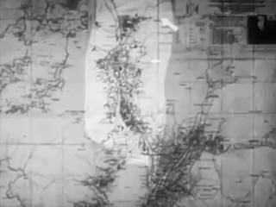
Notes:
Nuclear bombs dropped on Hiroshima and Nagasaki were 15 and 20 kilo-tons (of TNT) energy.

Slide 26
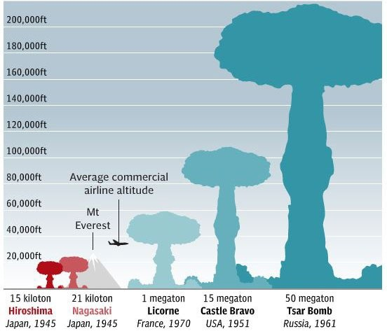
Notes:
Tsar bomb fireball would be about the size of San Antonio 410 inner loop
Portable devices estimated at 10 kiloton (generally used for planning purposes)

Slide 27
Initial Response
(Nuclear Warfare)

Slide 28
Nuclear Detonation Damage Pattern
Bomb Site
Severe Shockwave Zone
Lethal Radiation Zone
Severe Thermal Zone
Radioactive Fallout
Wind
Notes:
Note the best way to evacuate is at right angle to prevailing wind.
Fallout can be tricky to predict because winds blow at different directions depending on altitude

Slide 29
Be First.
Be Right.
Be Credible.
Notes:
Simple mantra of CERC (crises and emergency risk communication) by CDC

Slide 30
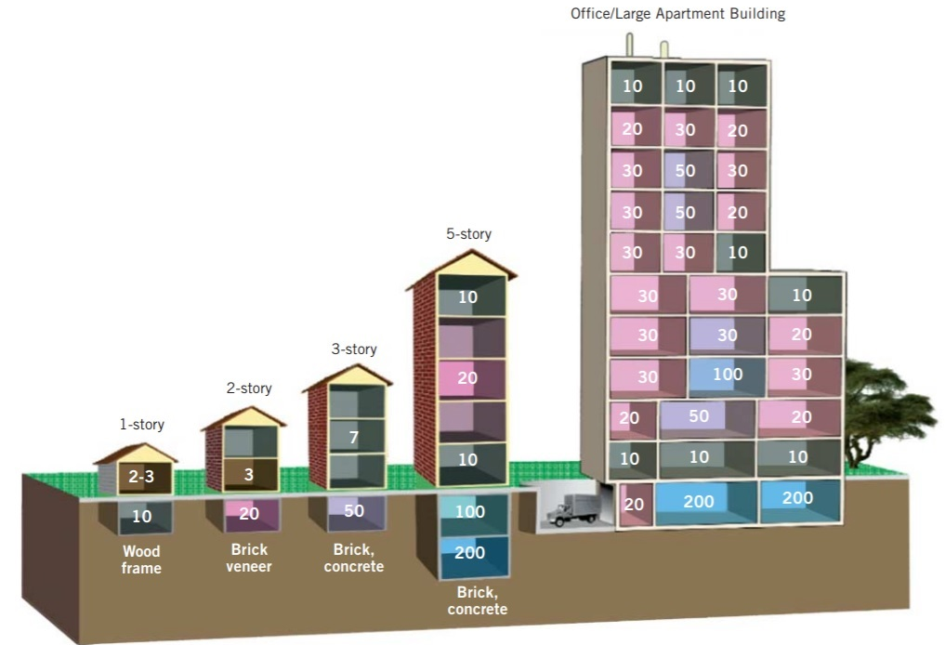
Building Dose Reduction Factor
Numbers represent dose reduction factors. Reduction factor of “10” indicates that a person in that area would receive 1/10th the dose compared to no shielding.
Buddemeier, B. R., & Dillon, M. B. (2009). Key response planning factors for the aftermath of nuclear terrorism (No. LLNL-TR-410067). Lawrence Livermore National Lab.(LLNL), Livermore, CA (United States).
Notes:
Buddemeier, B. R., & Dillon, M. B. (2009). Key response planning factors for the aftermath of nuclear terrorism (No. LLNL-TR-410067). Lawrence Livermore National Lab.(LLNL), Livermore, CA (United States).

Slide 31
Fallout Decay Rate
Time (hours) | Dose Rate (Gy/h) | Time (hours) | Dose Rate (Gy/h)
1 | 10 | 36 | 0.15
1.5 | 6.1 | 48 | 0.10
2 | 4 | 72 | 0.062
3 | 2.3 | 100 (~4 days) | 0.040
5 | 1.3 | 200 (~8 days) | 0.017
6 | 1 | 400 (~17 days) | 0.0069
10 | 0.63 | 600 (~25 days) | 0.0040
15 | 0.40 | 800 (~33 days) | 0.0031
24 | 0.23 | 1000 (~42 days) | 0.0024
Glasstone, S., & Dolan, P. J. (1977). The effects of nuclear weapons. DEPARTMENT OF DEFENSE WASHINGTON DC.
Notes:
“Dangerous fallout zone” considered when rate > 0.1 Gy/hr = acute radiation sickness risk
“Hot Zone” defined as rate > 0.0001 Gy/hr
Annual dose average in USA is 3.6 mGy per year.
So the inference is, generally its better to shelter in place. Instead of immediately trying to evacuate and exposing yourself to high levels of radiation.

Slide 32
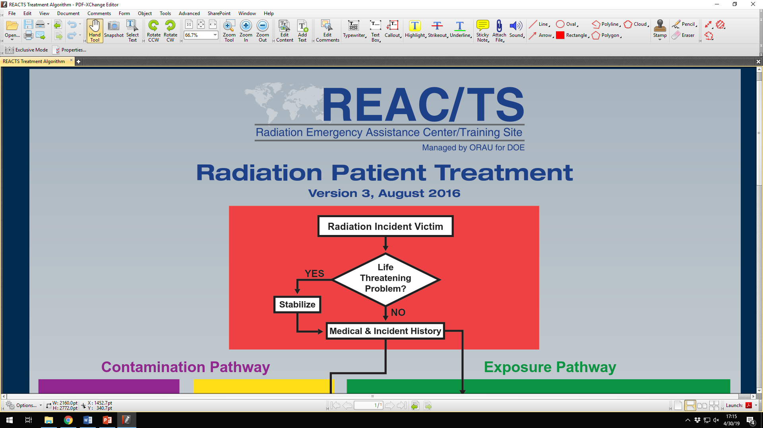
Notes:
Important to note that during triage, medical life threatening emergencies come prior to radiation related activities.
Can use any triage system however: Radiation dose or Burn > 15% TBSA increases triage level.
For decon:
Standard PPE acceptable.
Standard decon procedures generally acceptable. Remove clothing and scrub with soap/water. Thoroughly clean wounds and mucosal surfaces. When repeated cleaning no longer decreases count then can stop OR if count (bequerel) 2-3x background rate.

Slide 33

Notes:
Mental health will be a large part of the response, need to have a plan.
Tools like “PsySTART” can help in early response phase.

Slide 34
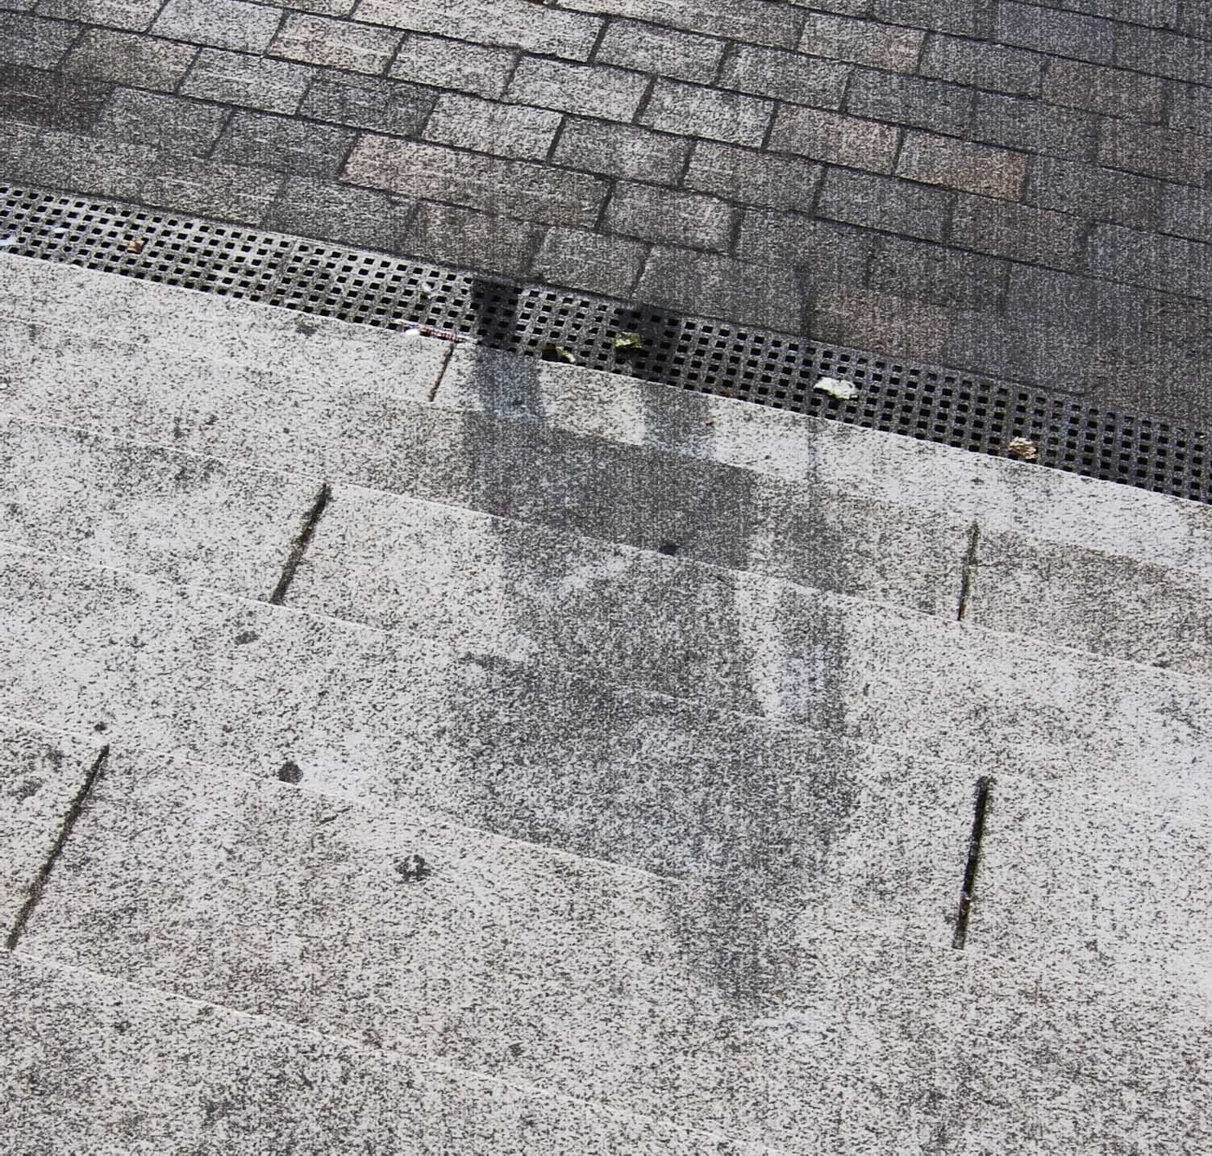
Notes:
Reminder to talk about morgue services. Will be overwhelmed, need to have a plan.
Shows the flash burn imprint of person after nuclear explosion.

Slide 35
Dose Estimation

Slide 36
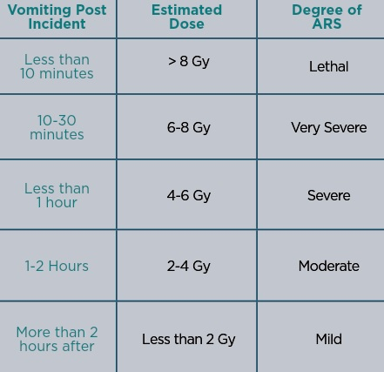
Adapted from: Berger Me, et al. Hospital Triage in the First 24 Hours After a Nuclear or Radiological Disaster. REAC/TS (Radiation Emergency Assistance Center/Training Site); https://www.orau.gov/reacts: 2004
Notes:
Clinical estimation. Based on time to vomiting.
ARS = Acute radiation Syndrome
Note extremes, < 10 min likely lethal; > 2 hours likely mild

Slide 37
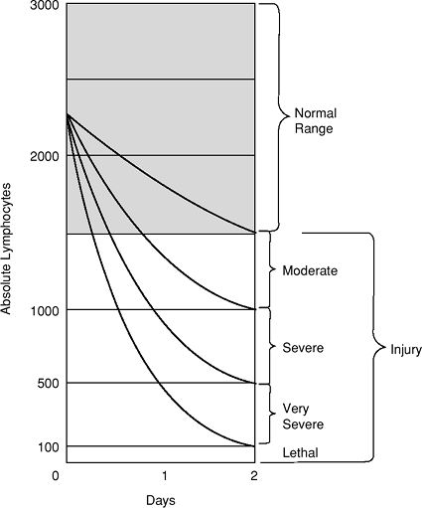
Andrews Nomogram
Andrews GA, Auxier JA, Lushbaugh CC. The Importance
of Dosimetry to the Medical Management of Persons Exposed
to High Levels of Radiation. In Personal Dosimetry for Radiation
Accidents. Vienna: International Atomic Energy Agency; 1965.
Notes:
Estimates radiation injury based on lymphocytes during first 48 hours.

Slide 38
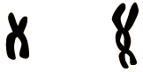
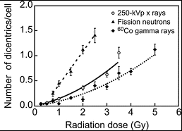
Dicentric Chromosome
Normal Chromosome
https://www.remm.nlm.gov/aboutdicentrics.htm
Notes:
Dicentric Chromosome Assay is based on the principle that radiation exposure causes DNA strand breaks, in particular double strand breaks. During repair of DNA strand breaks, misrepair of 2 chromosomes and abnormal chromosome replication can lead to dicentric chromosomes, that is, a chromosome with 2 centromeres.
Increases in radiation dose produce increasing numbers of dicentric chromosomes.
Although radiation induces many types of chromosomal changes in addition to dicentric chromosomes, dicentrics are considered the most sensitive and most specific for assessing radiation dose.
There is a good dose-effect relationship in the range of 0.05 Gy to 5.0 Gy for acute exposures to low linear energy transfer (LET) radiation
Requires 3-4 days for results to be received.
Few labs in the World capable of doing.

Slide 39
Acute Radiation Syndrome
(ARS)

Slide 40
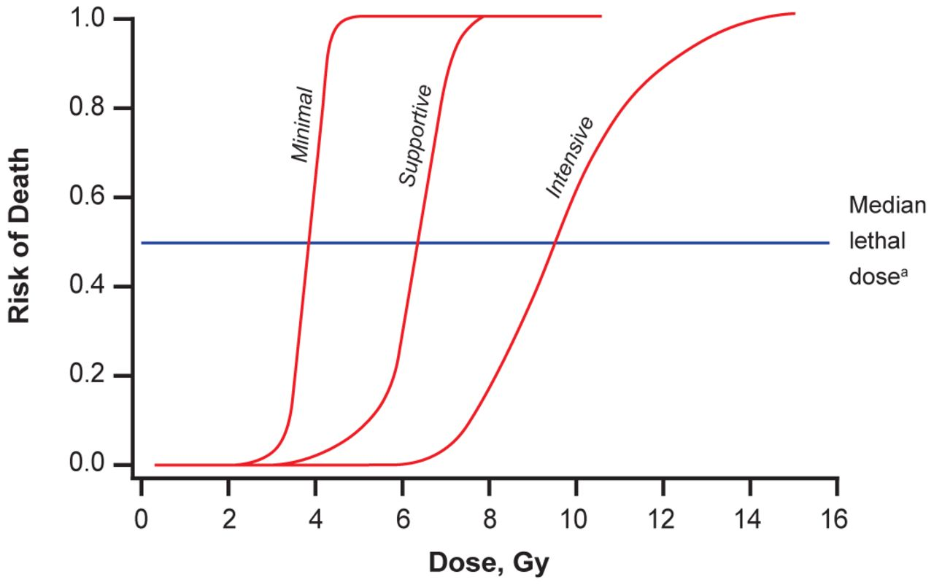
J Am Osteopath Assoc. 2014;114(9):702-711. doi:10.7556/jaoa.2014.138
Notes:
Ionizing radiation doses corresponding with risk of death by minimal, supportive, and intensive care received.
Median lethal dose results in fatalities in 50% of an untreated population within 60 days.

Slide 41
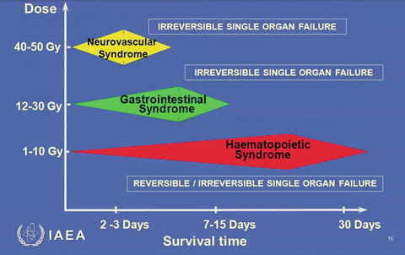
Notes:
4 stages:
Prodromal stage: GI related symptoms lasts 1-3 days.
Latent stage: days to weeks, may have no symptoms
Manifest illness depending on dose as below.
Recover or death. Most common cause of death is Sepsis.
Hematopoietic Syndrome: Can have 1-6 week latent period. Symptoms are fever, and malaise. Drop in all blood cell counts occurs for several weeks. Primary cause of death is infection and hemorrhage. Most deaths occur within a few months after exposure.
Gastrointestinal Syndrome: 1 week latent period. Symptoms are severe diarrhea, fever, dehydration, and electrolyte imbalance. Death is due to infection, dehydration, and electrolyte imbalance. Death occurs within 2 weeks of exposure.
Neurovascular Syndrome: Symptoms are return of watery diarrhea, convulsions, and coma. Onset occurs 5 to 6 hours after exposure. Death occurs within 3 days of exposure (cerebral edema and vascular leak).
Also the local cutaneous injuries.

Slide 42
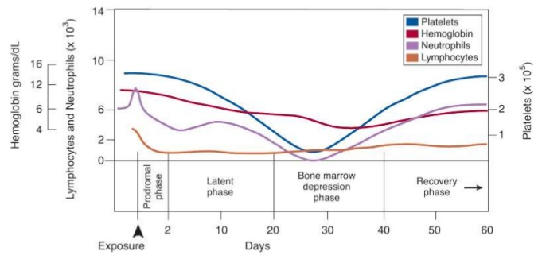
Hematologic Course with ~3Gy Dose
Andrews GA, Auxier JA, Lushbaugh CC. The Importance of Dosimetry to the Medical Management of Persons Exposed to High Levels of Radiation. In Personal Dosimetry for Radiation Accidents. Vienna: International Atomic Energy Agency; 1965.
Notes:
Chart shows outcomes of hematopoietic syndrome.

Slide 43
Medical Therapies

Slide 44

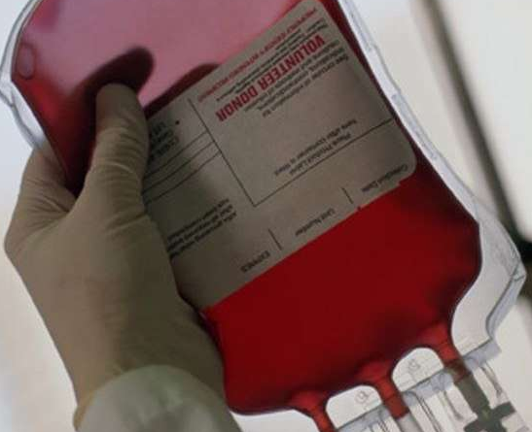
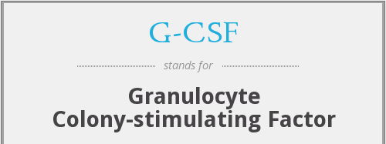
Notes:
Replace blood and platelets, normal transfusion guidelines.
Granulocyte colony-stimulating factor (G-CSF; filgrastim) and pegfilgrastim (the pegylated formulation of G-CSF) are approved by the US Food and Drug Administration (FDA) for patients acutely exposed to myelosuppressive doses of radiation (eg, >2 Gy) (Approval timeline: Filgrastim (March 2015), Pegfilgrastim (Nov 2015), Sargramostim (March 2018))
The benefit of recombinant human erythropoietin or darbepoetin in this setting has not been established, but can be considered in patients with persistent anemia and a hematocrit <30 percent.
For those who experience significant neutropenia (ie, absolute neutrophil count <500/microL), broad spectrum prophylactic antimicrobials should be employed, as the neutropenic duration is likely to be prolonged (table 9 and figure 1). Prophylaxis should include a fluoroquinolone (FQ) with streptococcal coverage (or penicillin or amoxicillin added to the FQ if it is not inherently covered by the FQ), an antiviral agent if the patient is herpes simplex virus (HSV) positive, and an antifungal agent

Slide 45
Internal Contamination Therapy
Contaminant | Treatment | Principal action(s)
Americium | Wound excision, Ca-DTPA or Zn-DTPA | Chelation
Californium
Cerium
Curium
Plutonium
Cesium | Prussian Blue | Accelerates removal
Rubidium
Thallium
Iodine | Potassium Iodide | Blocks thyroid uptake
Strontium | Aluminum antacids, Ammonium chloride, Calcium, Barium sulfate, Phosphate | Blocks GI absorption, promotes urinary excretion and mobilization from bone
Tritium | Fluids, Diuretics | Dilutes isotope and promotes diuresis
Uranium | Sodium bicarbonate | Decreases Uranyl nephrotoxicity
Revised from: Gusev I, Guskova AK, Mettler FA (Eds). Medical Management of Radiation Accidents, 2nd ed, CRC Press, Boca Raton, FL 2001.

Slide 46
Potassium Iodide Therapy Guide
Patient’s Age | Predicted Thyroid exposure (cGy) | Potassium Iodide dose (mg)
Over 40 yrs | > 500 | 130
18 – 40 yrs | > 10
Pregnant or lactating women | > 5
12 – 18 yrs* |  | 65
3 – 12 yrs
1 – 3 yrs |  | 32
0 – 1 month |  | 16
* Teen near adult size (>70kg) should receive adult dose (130mg)
Adapted from: https://www.fda.gov/regulatory-information/search-fda-guidance-documents/potassium-iodide-thyroid-blocking-agent-radiation-emergencies
Notes:
The protective effect of KI lasts approximately 24 hours. For optimal prophylaxis, KI should therefore be dosed daily, until a risk of significant exposure to radioiodines by either inhalation or ingestion no longer exists.
Most important in younger population as long term risk of thyroid cancer is higher.
The risks of stable iodine administration include sialadenitis (an inflammation of the salivary gland, of which no cases were reported in Poland among users after the Chernobyl accident), gastrointestinal disturbances, allergic reactions and minor rashes.

Slide 47
Real Life

Slide 48
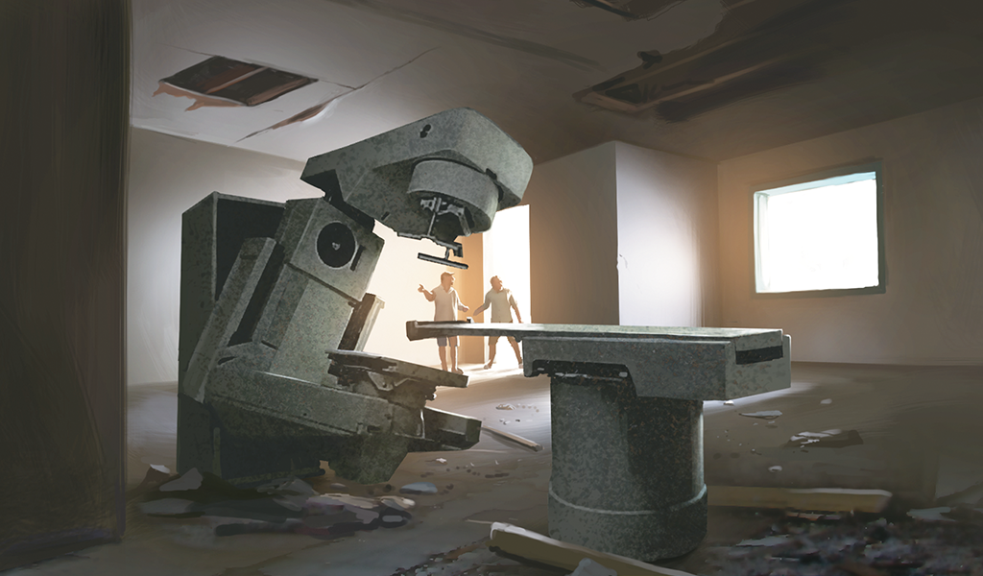
Goiania, Brazil, 1985
Notes:
Goiania Incident
1985 a private radiotherapy institute, the Institute Goiano de Radioterapia in Goiania, Brazil, moved to new premises, leaving in place a caesium-137 teletherapy unit without notifying the licensing authority.
The Cesium-137 source glowed blue in the dark. So it was shown to and given away to family/friends (size of grains of rice)
In total, some 112 000 persons were monitored, of whom 249 were contaminated either internally or externally
20 persons were identified as needing hospital treatment
4 deaths
The dose estimates varied from zero up to 7 Gy

Slide 49
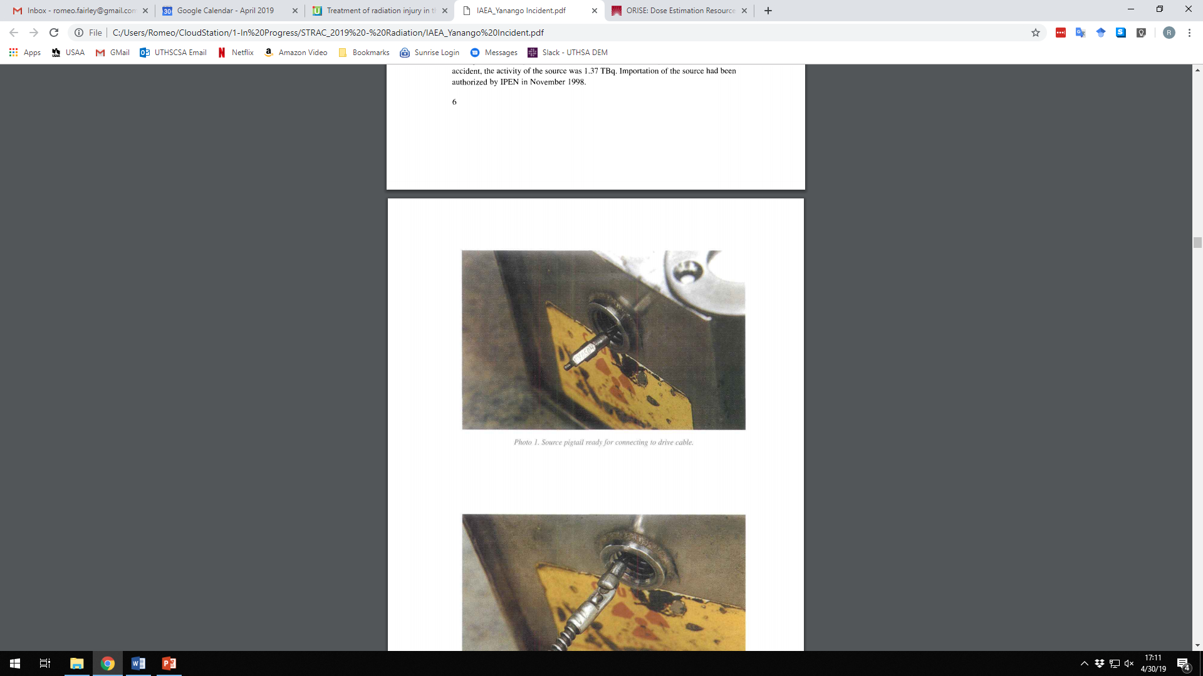
Yanango, Peru
20 February 1999
Notes:
20 February 1999, Yanango hydroelectric power plant in Peru when a worker (a welder) picked up an 192Ir industrial radiography source and put it in his pocket, where it remained for approx. 6 hours.
1.37 TBq of Ir-192

Slide 50
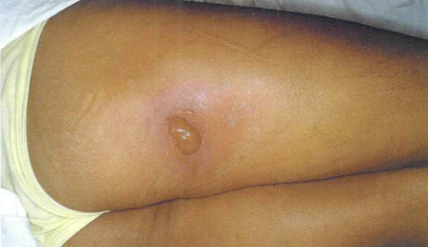
22 February 1999
Notes:
2 days later

Slide 51
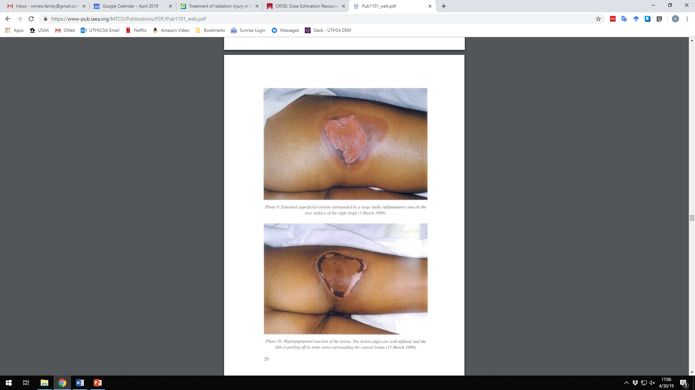
1 March 1999
Notes:
1 March 1999

Slide 52
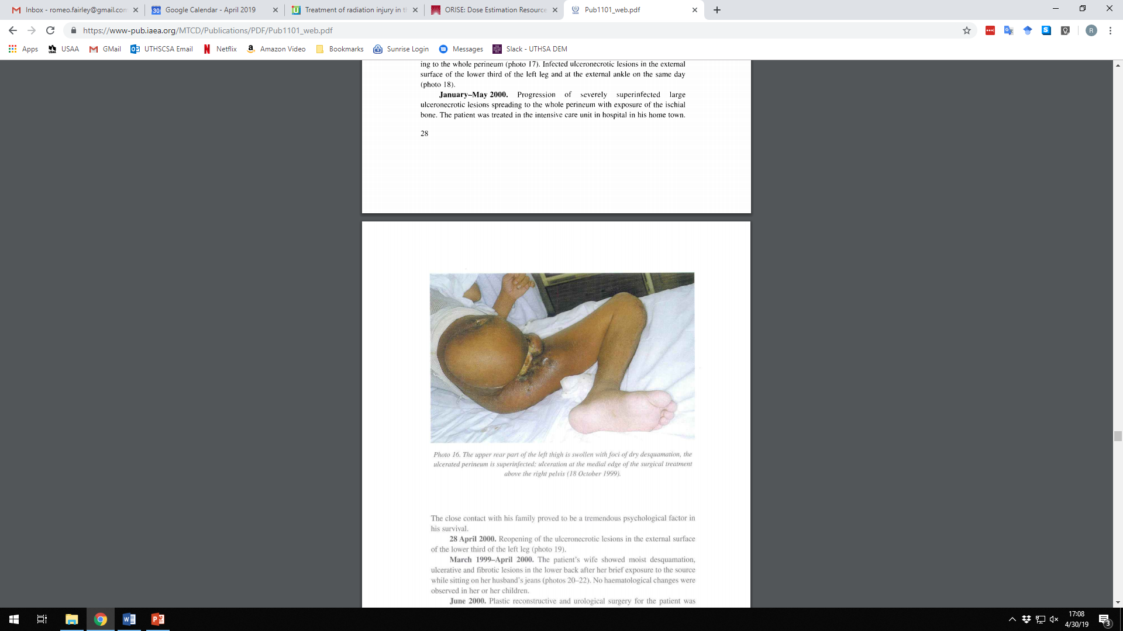
18 October 1999
Notes:
18 October 1999

Slide 53
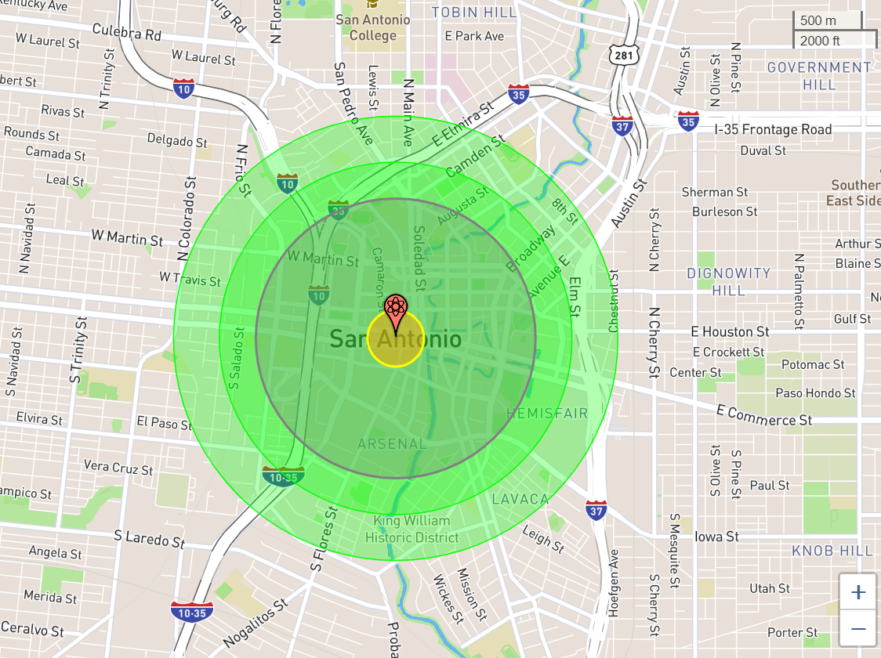
Fireball radius: 200m
Air blast radius (5 psi): 1km,
“moderate damage”
5 Gy Radiation radius: 1.25km, 50-90% fatal
1 Gy Radiation radius: 1.57km, likely radiation sickness symptoms
https://nuclearsecrecy.com/nukemap/
Notes:
10kT surface blast
“Moderate damage (MD) zone” = misnomer, most residential buildings destroyed, concrete buildings severely damaged, significant morbidity/mortality
The MD zone should be the focus of early life-saving operations. Early response activities should focus on medical triage with constant consideration of radiation dose minimization.

Slide 54
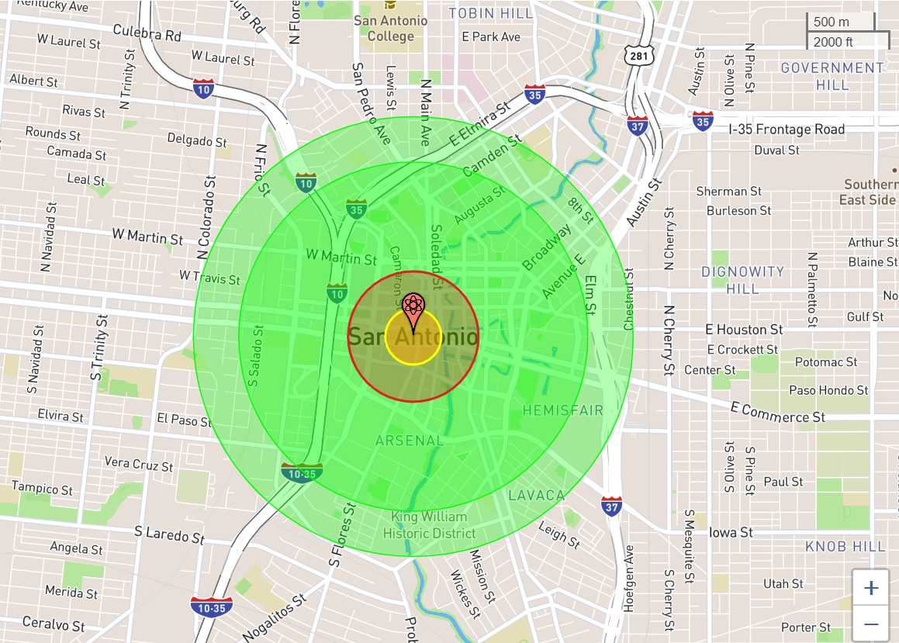
Estimated fatalities: 20,310
Estimated injuries: 24,880
https://nuclearsecrecy.com/nukemap/
Notes:
10kT surface blast
In any given 24-hour period, there are approximately 78,919 people in the 1 psi range of the most recent detonation.

Slide 55
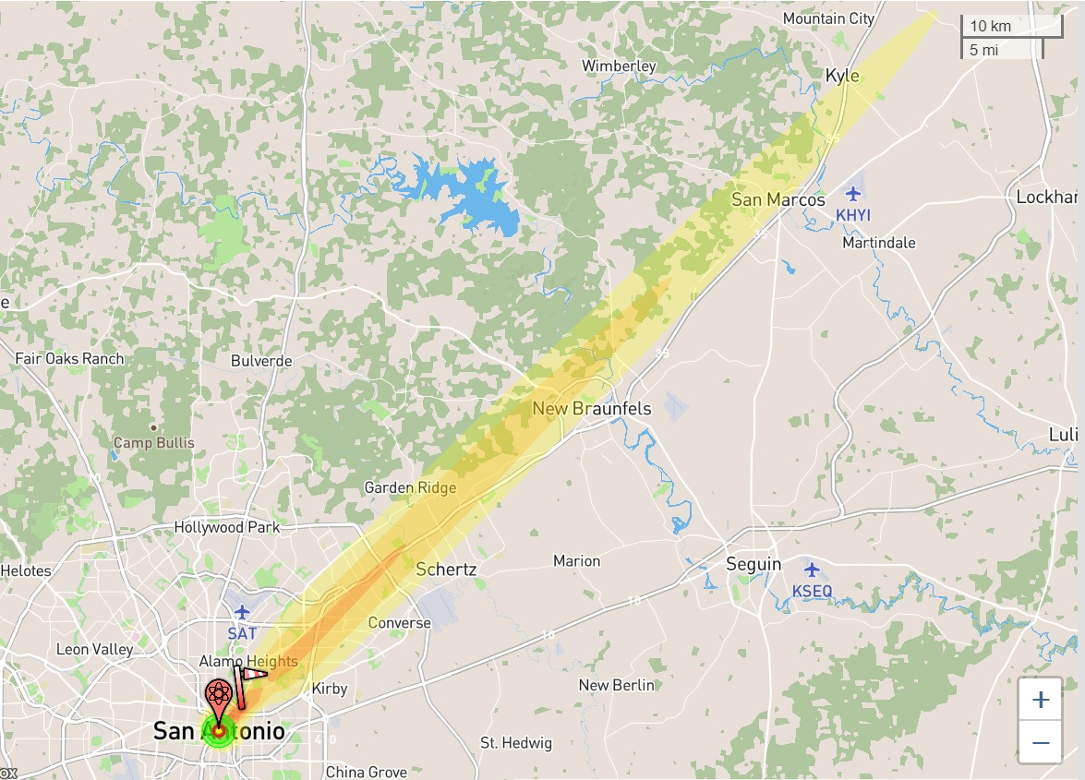
10 kT surface burst
15 mph wind
0.01 Gy per hour
0.1 Gy per hour
1.0 Gy per hour
https://nuclearsecrecy.com/nukemap/
Notes:
Fallout Estimation
“Dangerous fallout zone” considered when rate > 0.1 Gy/hr = acute radiation sickness risk
“Hot Zone” defined as rate > 0.0001 Gy/hr
https://nuclearsecrecy.com/nukemap/
10 kiloton surface burst with a 15 mph wind
Surface burst has more fallout due to the fireball sucking up debris into the air/atmosphere

Slide 56
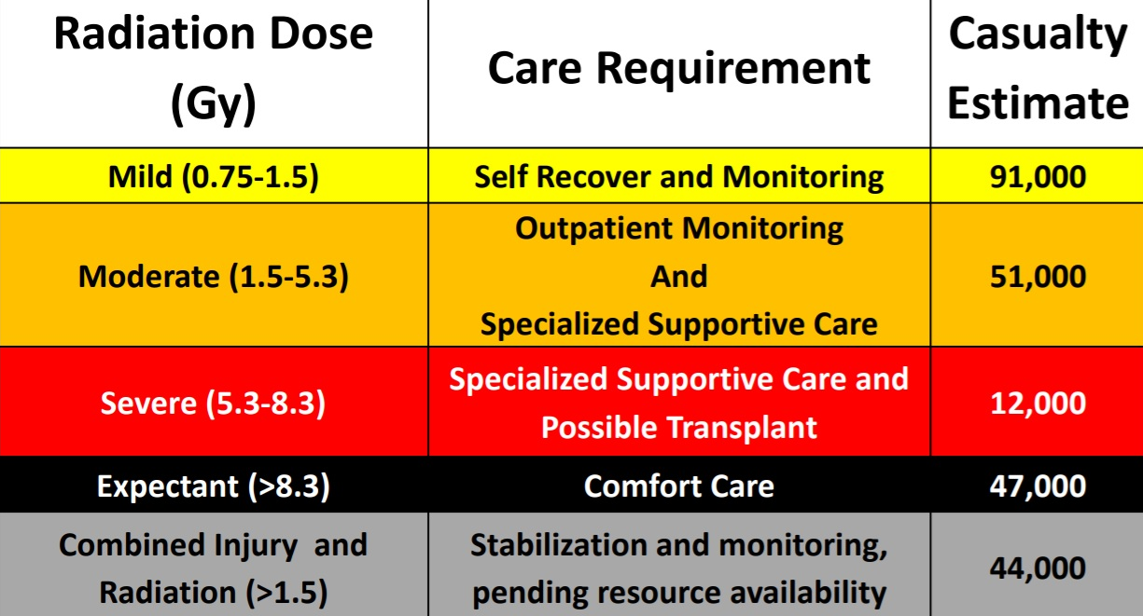
Estimated Casualties from 10kT Detonation
Knebel, A. R., Coleman, C. N., Cliffer, K. D., Murrain-Hill, P., McNally, R., Oancea, V., ... & Hrdina, C. M. (2011). Allocation of scarce resources after a nuclear detonation: setting the context. Disaster medicine and public health preparedness, 5(S1), S20-S31.
Notes:
10kT surface burst, modeling of a range of 185 scenarios with various nuclear detonation yields (0.1–10 kT), heights of burst (ground and air), and weather conditions, in several major US cities.
Adopted for planning purposes by Radiation Injury Treatment Network (RITN)

Slide 57


