Slide 1
ACEP DISASTER MEDICINE PLANETARY PROTECTION
“There are things in heaven and earth, my dear Horatio, that have not even been dreamt of in your philosophies.” Hamlet.

Slide 2
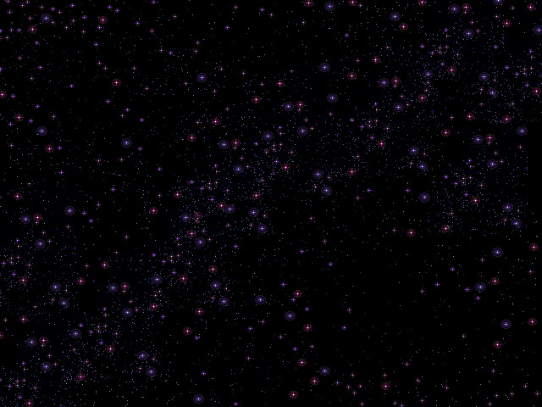

Slide 3
The Probability of Life Beyond Our Own Planet:
The Drake equation is most often used to predict the probability of encountering life beyond our own planet. As you can see by the foregoing estimates, extraterrestrial life is likely to be out there , just waiting to be discovered.

Slide 4
The Drake Equation
The Drake equation is:
N = R ∗ ⋅ f p ⋅ n e ⋅ f l ⋅ f i ⋅ f c ⋅ L where:
N = the number of civilizations in our galaxy with which communication might be possible (i.e. which are on our current past light cone);
R∗ = the average rate of star formation in our galaxy
fp = the fraction of those stars that have planets

Slide 5
The Drake Equation (cont.)
ne = the average number of planets that can potentially support life per star that has planets
fl = the fraction of planets that could support life that actually develop life at some point
fi = the fraction of planets with life that actually go on to develop intelligent life (civilizations)
fc = the fraction of civilizations that develop a technology that releases detectable signs of their existence into space
L = the length of time for which such civilizations release detectable signals into space
The result: : as many as 100 million in our galaxy
This does not include the many other potential forms of life possible

Slide 6
PLANETARY PROTECTION
Protection from Asteroid Impacts
Protection from Extraterrestrial Contamination
We do this to protect our future, our children’s future, and the future of our species.

Slide 7
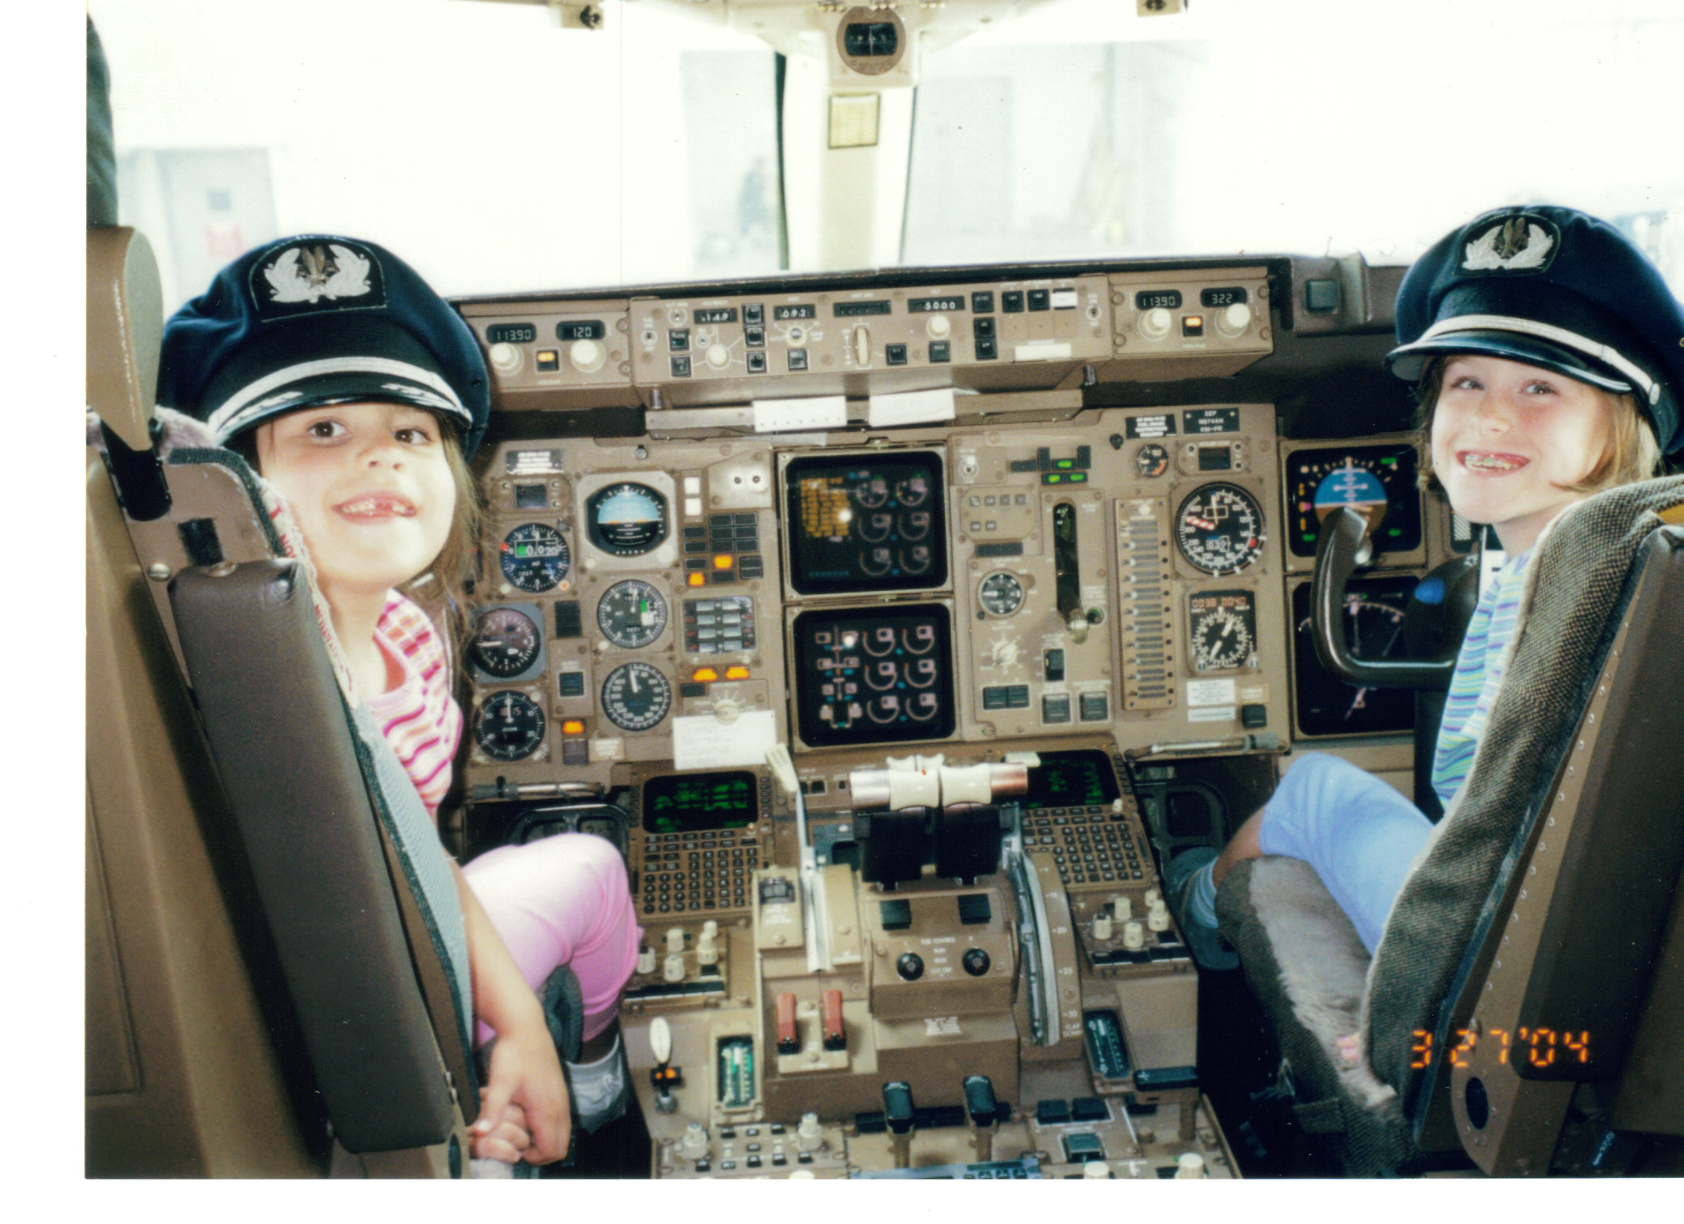

Slide 8
Asteroid Impact Concerns:
The asteroid depicted in the following slides was once thought to be on a collision course with earth and although only 300 feet across – would have killed 10 million people.
It is now calculated for a clean miss .

Slide 9
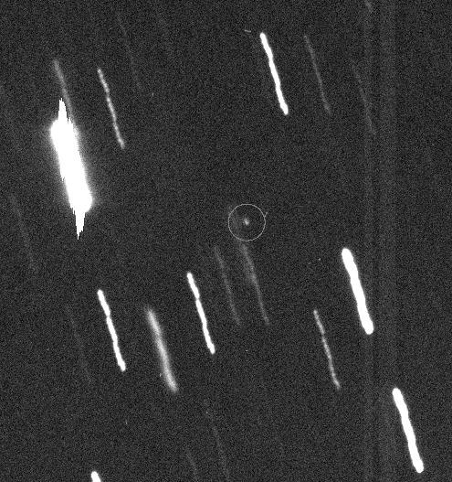
APOPHIS

Slide 10
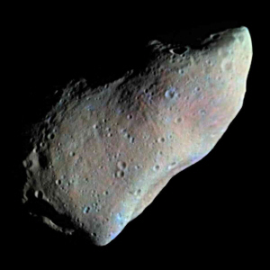
APOPHIS

Slide 11
Asteroid Impact Risk
60-100 meters diameter ( Arizona crater, Siberia) every 500-1000 years.
1 kilometer ( climate change) every million years
Greater than 5 kilometers (mass extinction) every 50-100 million years.

Slide 12
Asteroid Impact Migation
Astronomical surveillance
Tracking of known objects
Developing rendezvous and interdiction capabilities
NASA Planetary Defense Coordination Office – Lindley Johnson Lindley.johnson@NASA.gov
Disaster management post impact

Slide 13
Asteroid Impact Considerations:
Depending upon lead time and trajectory estimates ( we could have days to weeks)
Could be like Hurricane evacuations from strike zones and coastal regions ( from tsunami oceanic impacts)
Disaster Medical management in the aftermath for survivor injuries and medical care for displaced refugees.

Slide 14
Planetary Protection for Extraterrestrial Explorations
Protecting the rest of the universe from us – avoiding forward contamination of other worlds
(being a good citizen of the Universe)
Protecting our planet from returning ( back) contamination –
Additional Considerations -

Slide 15
Microbial life is complicated
99% of all micro-organisms on earth cannot be cultured in the laboratory.
Micro-organisms thrive in a remarkably diverse range of environmental habitats , many of which would be considered hostile to human life ( Extremophiles).

Slide 16
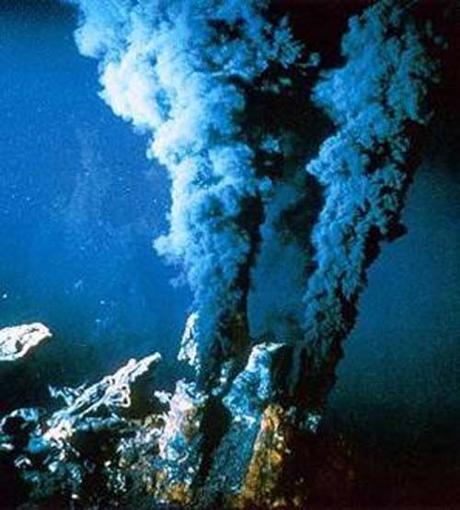
UNDERSEA LAVA VENT

Slide 17
Extremophiles in the Earth Environment
Sulfide Chimney conduits for hot (>250 degrees C) reduced metal-bearing fluids from the seafloor still supports microbial life.
. Deinococcus radiodurans “strange berry that withstands radiation”
Can survive 15,000 grays (Gy) of ionizing radiation Mends double-strand DNA breaks
Doses <10 Gy are lethal to most other micro-organisms
Typical X-ray ~ 1.4 milligrays

Slide 18
International Outer Space Treaty - 1967
Provided that weapons should not be propagated into space.
Secured the right of all nations to explore space peacefully.
Established the basis for the protection of other celestial bodies from contamination by these explorations from earth. ( the origin of traditional planetary protection)

Slide 19
Planetary Protection While We Explore the Cosmos
The principles for reducing the risk of forward contamination from earth to other celestial bodies during our explorations were established for the Viking Mars lander program, and include estimating the residual contamination and the risk for uncontrolled impact during spacecraft flybys.

Slide 20
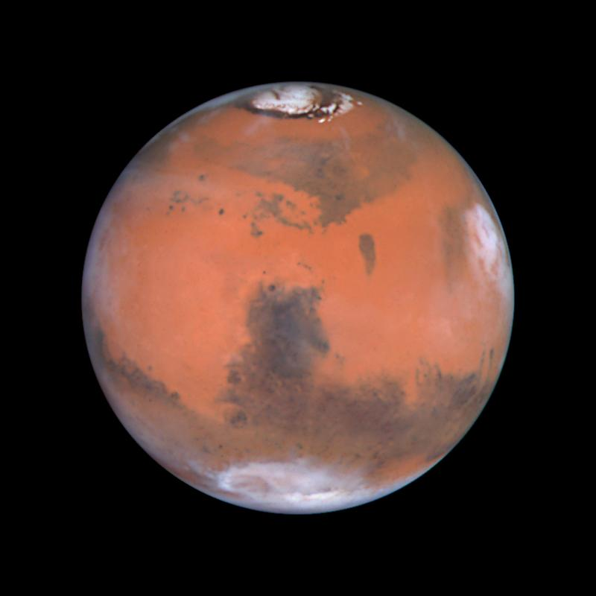

Slide 21
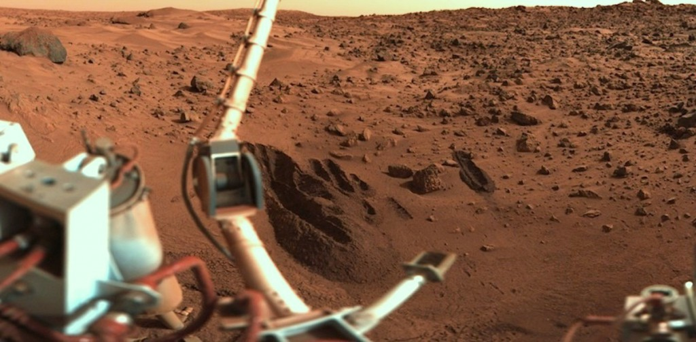
VIKING MARS LANDER

Slide 22
The Viking ( Mars Lander) Program Experience
The contamination equation for the lander is:
Pc = Summation N0 PsPr Pg where:
•Pc is the probability of contaminating Mars;
• N0 is the number of organisms present before sterilization;
•Ps is the probability that a randomly selected organism will survive sterilization;
• Pr is the probability of release, and
•Pg is the probability of growth

Slide 23
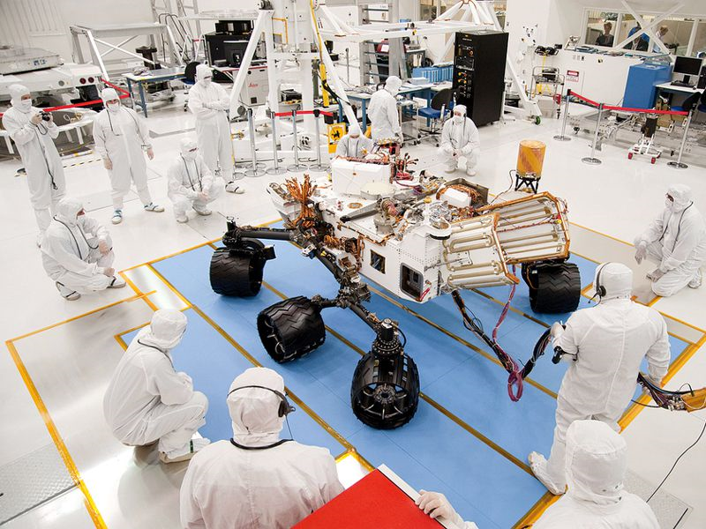
Spacecraft Processing

Slide 24
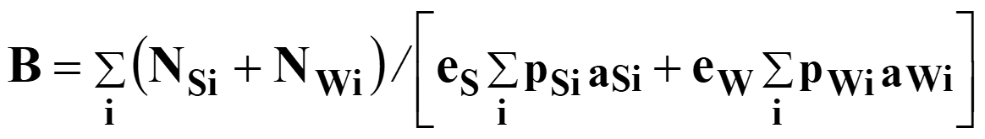
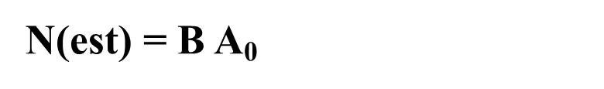
PROBABILITY ESTIMATES of CONTAMINATION
The best formula to estimate the spores on the area represented by a sample set (assay group) is:

Slide 25
Impact Prediction Equation
P I = summation j pj qj+1
• For impact, have probability of impact after each maneuver and the probability of no further maneuvers because of a failure before it is scheduled pj q j+1 (AND rule)
• Impact may occur if this happens for any maneuver. The probabilities must be added because this is one or another (OR rule).
• Method used for the cruise phase:
– pj is the a priori(before the maneuver is executed) probability of a maneuver leading to an impact trajectory
– qj+1 is the probability that the next maneuver fails to occur (i.e., a system failure or meteoroid impact kill).
– launch, or the injection maneuver, if separate, is the first j.
– note that for the last maneuver k, qk+1 =1

Slide 26
Return Contamination of the Earth
The estimated probability of finding a living organism is very low in the near term.
The probability that an organism would survive the journey and be able to grow is even much smaller.
The probability for an organism surviving which could produce human disease is considered infinitesimally small.

Slide 27
Returning Astronaut Quarantine
There will be countermeasures and safeguards in place to ensure containment of any micro-organisms within return samples.
The initial CDC level isolations are expected to be Bio Safety Level 4.
There is ongoing discussion regarding the length and degree of astronaut quarantine which might be required for return from beyond the moon.

Slide 28
The Health Stabilization Program
This was implemented during the Apollo program as a type of pre-flight quarantine to keep the Crew healthy into launch.
Only those certified as Prime Crew Contacts could have contact with Crewmembers.
Those PCCs were educated to also avoid exposure and to cease contact if exposed or ill.
This could be expanded in reverse for Mars missions.

Slide 29
The Apollo Program Legacy
In 1969 prior to the Apollo 11 moon launch, Dr. Charles Berry , the Crew Flight Surgeon, denied the request of the president to break pre-flight quarantine to meet with the Crew.
This is how we keep our Crews safe and well.
Apollo 11 was the first Crew post-flight quarantine. We can expect more for Mars.

Slide 30
The Evidence for Martian Life May Already be Here
Martian Methane gas production seasonal variation
Antarctic meteorite likely from Mars with fossilized structures of life-like remnants.
Human circadian rhythm is 25 hours and closer to Martian day than to an earth day.

Slide 31
Planetary Protection ACEP Role:
Advisory and educational inputs to members preparing for, planning , and responding to planetary protection contingencies ( Asteroids) within their designated disaster team or other agency responsibilities.

Slide 32
ACEP role(continued)
The ACEP role in other planetary protection ( such as microbiological) events is expected to be minimal at this time. Local EM resources involved in recovery and processing of extra-terrestrial samples are already being advised by NASA and can reach out to the EM community for additional support as needed. Routine maintenance of the current Infectious Disease precautions is reasonable mitigation for other locations.

Slide 33
Planetary Protection Interfaces:
NASA PPO(Planetary Protection Office)
NASA Planetary Defense Coordination Office
CDC
FEMA
FAA
AsMA ( Aerospace Medical Association)
ACEP Disaster Medicine Sections and Teams

Slide 34
Planetary Protection Future Events:
We will keep you posted on this website as information becomes available regarding contingency planning for future events.

Slide 35
Planetary Protection Contacts:
K. Jeffrey Myers MD FACEP – ACEP DMS Lead for Planetary Protection Contingency Niche
321-482-1577 rocketranger21@bellsouth.net
Lindley Johnson- Planetary Defense Coordination Office (Asteroid impact concerns) Lindley.Johnson@nasa.gov

Slide 36
